Slide 1


Data Science Fundamentals
College of Computer Science And Information Technology
2
+
Data Mining Process and Visualization
2
+
Session 1
Introduction

Slide 2
Cross Industry Standard Process for Data Mining (CRISP-DM) process
Business
Understanding
Data Understanding
Data Preparation
Data
Deployment
Modeling
Evaluation

Slide 3
Data Science Process
Business
Understanding
Data Understanding
1. Prior Knowledge
Prepare Data
2. Preparation
Building Model using Algorithms
Training Data
Applying Model and performance evaluation
3. Modeling
Test Data
Deployment
4. Application
Knowledge and Actions
5. Knowledge
Notes:
Framework we will be using throughout this training
Central lynchpin in the entire framework is: Algorithms
…let’s double click on Algos

Slide 4
Cross Industry Standard Process for Data Mining (CRISP-DM) process
The process of data mining typically follows a set of well-defined industry-standard steps. These steps are often represented as a framework for guiding data mining projects. One common framework is the Cross-Industry Standard Process for Data Mining (CRISP-DM), which consists of the following stages:
Business Understanding:
Define the objectives: Understand the business problem or research question you want to address through data mining.
Assess the situation: Evaluate resources, constraints, and risks.
Produce a project plan: Create a timeline and allocate resources.
Data Understanding:
Collect data: Gather data from various sources.
Describe data: Explore the data to gain an initial understanding of its structure and quality.
Explore data: Perform basic statistics and visualizations to identify patterns and anomalies.

Slide 5
Cross Industry Standard Process for Data Mining (CRISP-DM) process
Data Preparation:
Clean data: Address missing values, outliers, and inconsistencies.
Select data: Choose relevant attributes or features.
Construct data: Create new variables or features.
Integrate data: Combine data from multiple sources.
Format data: Prepare data for analysis, which may involve normalization or transformation.
Modeling:
Select modeling techniques: Choose the appropriate data mining algorithms based on the problem (e.g., decision trees, neural networks, clustering algorithms).
Build models: Train and test models using the prepared data.
Assess models: Evaluate the performance of models using appropriate metrics.

Slide 6
Cross Industry Standard Process for Data Mining (CRISP-DM) process
Evaluation:
Evaluate results: Assess the models’ effectiveness in solving the problem.
Review the process: Reflect on the entire data mining process and identify any areas for improvement.
Deployment:
Plan deployment: Develop a plan for integrating the data mining results into operational processes or decision-making.
Monitoring: Continuously monitor the performance of deployed models and make updates as necessary.
Documentation:
Document the process: Maintain records of the entire data mining project, including methodologies, decisions, and results.
Create a final report: Summarize the findings and insights in a clear and understandable manner.

Slide 7
Terminology used in the data science
A dataset (example set) is a collection of data with a defined structure.
A data point (record, object or example) is a single instance in the dataset. Each row in a table is a data point. Each instance contains the same structure as the dataset.
An attribute (feature, input, dimension, variable, or predictor) is a single property of the dataset. Each column in a table is an attribute. Attributes can be numeric, categorical, date-time, text, or Boolean data types.
A label (class label, output, prediction, target, or response) is the special attribute to be predicted based on all the input attributes.
Identifiers are special attributes that are used for locating or providing context to individual records. For example, common attributes like names, account numbers, and employee ID numbers are identifier attributes. Identifiers are often used as lookup keys to join multiple datasets.

Slide 8
More examples of Data Preparation
Data Exploration: Perform basic statistics and visualizations to identify patterns and anomalies.
Handling missing values: detect the unknown values.
Data type conversion: convert the type of data (int, float, date, etc)
Transformation: reshaping and pivoting.
Outliers: values that have a significant difference from the mean.
Feature selection: choose that features that are strongly related to the target.
Sampling: check the class imbalance and fix it.

Slide 9
Modeling
A model is the abstract representation of the data and the relationships in a given dataset.
Training Data
Build model
Test Data
Evaluation
Final Model

Slide 10
Implementation steps of a machine learning models.
Define the Problem
Clearly define the problem you want to solve. What is the goal of your machine learning model? What type of data do you need to work with?
Gather and Prepare Data:
Collect and preprocess your data. This often involves data cleaning, feature engineering, and splitting the data into training and testing sets.
Select a Model:
Choose an appropriate machine learning algorithm based on the nature of your problem (e.g., classification, regression, clustering) and the type of data (structured or unstructured).

Slide 11
Train the Model:
Use the training data to train your machine learning model. The model learns from the data and tries to identify patterns or relationships.
Evaluate the Model:
Assess the model’s performance using evaluation metrics such as accuracy, precision, recall, or mean squared error, depending on the problem type.
Hyperparameter Tuning:
Fine-tune the model by adjusting hyperparameters (e.g., learning rate, depth of a decision tree) to improve its performance.
Cross-Validation:
Use techniques like cross-validation to ensure the model’s generalization ability and avoid overfitting.

Slide 12
Test the Model:
Once satisfied with the model’s performance, evaluate it on a separate test dataset to simulate its real-world performance.
Deploy the Model:
If the model meets your requirements, deploy it in a real-world application, which may involve integrating it into a software system.
Monitor and Maintain:
Continuously monitor the model’s performance in the production environment and retrain it periodically to adapt to changing data patterns.
Documentation:
Document the model, including its architecture, hyperparameters, and any special considerations, to facilitate future maintenance and collaboration.

Slide 13
Introduction of Pandas
Python

Slide 14
Python – Panda DataFrame
What is a DataFrame?
Locate Row
Named indexes
Locate named indexes
Load files into a dataFrame

Slide 15
What is DataFrame
It is a 2 dimensional data structure. A table with rows and columns
import pandas as pd
data = {
"calories": [420, 380, 390],
"duration": [50, 40, 45]
}
#load data into a DataFrame object:
df = pd.DataFrame(data)
print(df)
 | calories | Duration
0 | 420 | 50
1 | 380 | 40
2 | 390 | 45

Slide 16
Locate Row
Pandas use the loc attribute to return one or more specified row(s)
print(df.loc[0])
What this command do?:
print(df.loc[[0, 1]])
Index
 | calories | Duration
0 | 420 | 50
1 | 380 | 40
2 | 390 | 45

Slide 17
Name the index
df = pd.DataFrame(data, index = [“Day1", “Day2", “Day3"])
print(df.loc["day2"])
 | calories | Duration
Day1 | 420 | 50
Day2 | 380 | 40
Day3 | 390 | 45

Slide 18
Load files into a DataFrame
import pandas as pd
df = pd.read_csv('data.csv')
print(df)

Slide 19
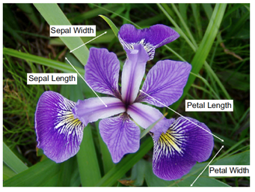
Plotting and Visualization
IRIS dataset

Slide 20
Why data visualization is very important?
Understanding Data: Data visualization helps you understand your data. It allows you to see patterns, trends, and relationships that might not be apparent when looking at raw data. Visualizations make complex data more accessible and interpretable.
Communication: Data visualizations are an effective means of communicating insights and findings to others, whether it’s your team, management, or the general public. A well-designed visualization can convey information more quickly and clearly than tables or text.
Decision-Making: Visualizations assist in making informed decisions. They provide a visual summary of information, which can be crucial for decision-makers who need to quickly grasp the implications of data.
Spotting Anomalies and Outliers: Visualizations make it easier to identify anomalies, outliers, or irregularities in the data. These anomalies can be critical in various fields, from fraud detection to quality control.

Slide 21
Exploration and Discovery: Data visualization encourages exploration. By interacting with visual representations of data, you can uncover unexpected insights or ask new questions about the data.
Comparison and Benchmarking: Visualizations allow you to compare different data sets, variables, or groups. This is essential for benchmarking performance, assessing the impact of changes, or evaluating alternatives.
Storytelling: Visualizations help in telling a compelling data-driven story. Whether it’s in a business report, a research paper, or a presentation, visualizations make your narrative more engaging and persuasive.
Monitoring and Tracking: Real-time or periodic data visualizations are used to monitor ongoing processes, track key performance indicators (KPIs), and make timely adjustments when necessary.
Pattern Recognition: Visualizations make it easier to identify recurring patterns, which can be valuable for predicting future trends and making forecasts.

Slide 22
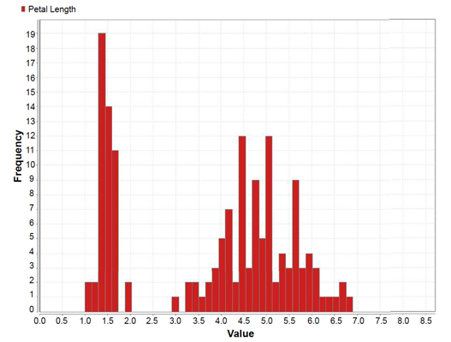
Data Visualization - plots
Histogram:
a diagram consisting of rectangles whose area is proportional to the frequency of a variable and whose width is equal to the class interval.
Pros and cons
Histograms are useful and easy, apply to continuous, discrete and even unordered data
They use a lot of ink and space to display very little information
It's difficult to display several at the same time for comparisons

Slide 23
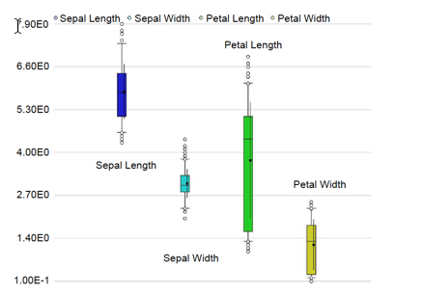
Data Visualization
Box plot:
A box plot is a graphical rendition of statistical data based on the minimum, first quartile, median, third quartile, and maximum. The term "box plot" comes from the fact that the graph looks like a rectangle with lines extending from the top and bottom.
Advantages: The box plot organizes large amounts of data, and visualizes outlier values.
Disadvantages: The box plot is not relevant for detailed analysis of the data as it deals with a summary of the data distribution.

Slide 24
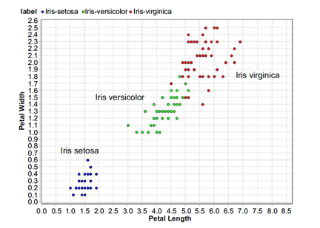
Data Visualization
Scatter plot
is a chart that shows the relationship between two variables. They are an incredibly powerful chart type, allowing viewers to immediately understand a relationship or trend, which would be impossible to see in almost any other form.
Advantages: summarize a large dataset in visual form; easily compare two or three data sets; better clarify trends than do tables; estimate key values at a glance.
Disadvantages: require additional written or verbal explanation; can be easily manipulated to give false impressions.

Slide 25
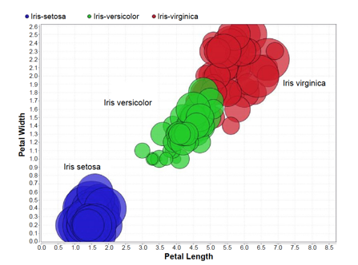
Data Visualization
Bubble plot
A bubble plot is a relational chart designed to compare three variables. Unlike other three-dimensional charts that process and represent data across three axes (usually x, y, and z), a bubble chart is represented on two axes (x and y), and the size of the bubble communicates the third, vital piece of information.
Disadvantages: due to circle sizes, can be difficult to ascertain actual values; difficult to read and understand; cannot be used to display a lot of data.

Slide 26
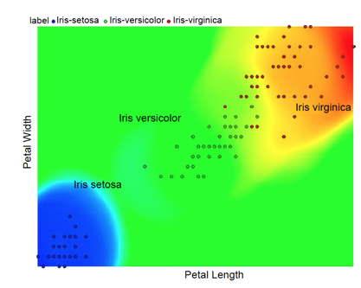
Data Visualization
Density chart
A Density Plot shows the distribution of data over a continuous interval or time period. This chart is a variation of a Histogram that uses kernel smoothing to plot values, allowing for smoother distributions by smoothing out the noise.
Advantages of Density
Not heavily influenced by plot size since expressed on area basis.
Sensitive to changes in recruitment and mortality.
Not sensitive to changes in phenology.
Easy to measure.
The plot is dependent on choosing the correct bandwidth in order to best display the data, and if the choice of bandwidth is incorrect, it can distort the data by over- or under-smoothing.

Slide 27
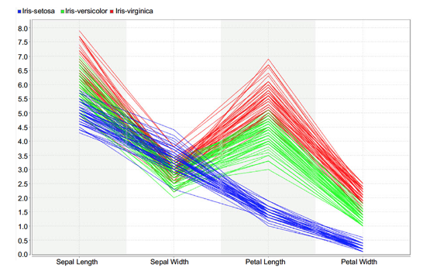
Data Visualization
Parallel chart:
A parallel coordinate plot maps each row in the data table as a line, or profile. Each attribute of a row is represented by a point on the line.
Advantage of the parallel coordinate plot is its ability to represent high dimensional data as a two-dimensional visualization.
The downside to Parallel Coordinates Plots, is that they can become over-cluttered and therefore, illegible when they're very data-dense.

Slide 28
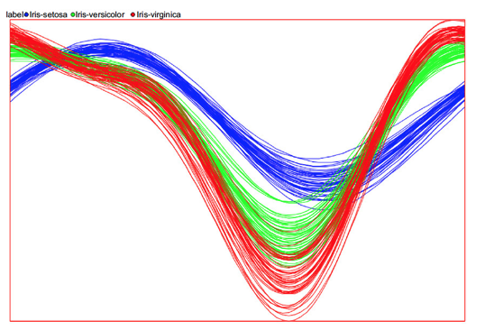
Data Visualization
Andrews curves:
a visualization technique used to identify underlying structure in multidimensional data.
Andrews curves reduce multiple features into low dimensional space to display relationships with target variables or classifications. Andrews curves work by mapping all features from a single observation or row of data onto a function.
The resulting function output creates a unique curve, maintaining relative distance and variance across all features per function coefficient and between observations.

